Slide 1
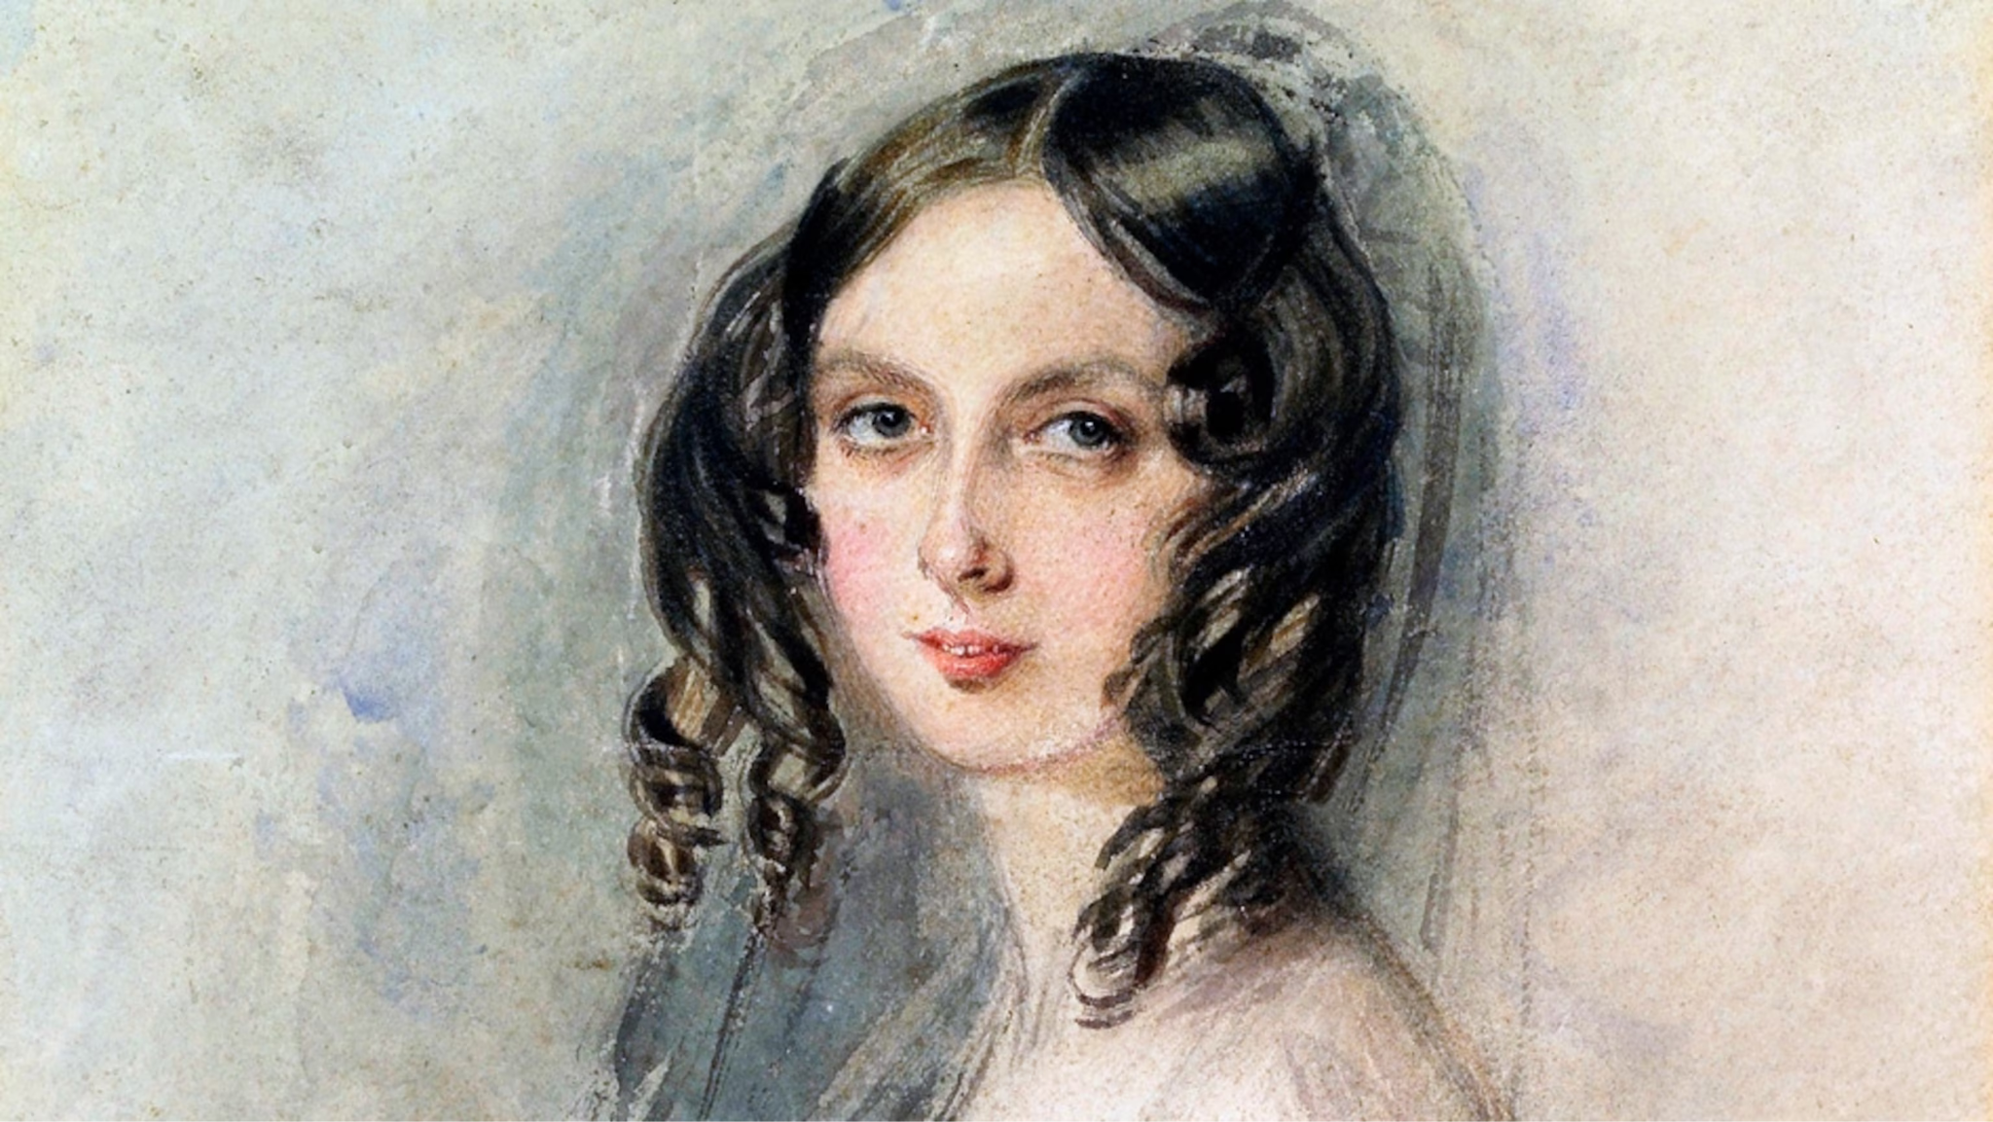
Introduction
Named Ada after Augusta Ada Byron (1815–1852), the first programmer
Inspired by Pascal and other languages
Improves code safety and maintainability by using the compiler to find errors in favor of runtime errors
International technical standard
Ada is: structured, statically typed, Imperative, Object-oriented, high-level

Slide 2
Background
Designed by Jean Ichbiah of Honeywell under United States Department of Defense (DoD) from (1977 - 1983)
To supersede over 450 programming languages used by the DoD at that time.
Huge design effort, involving hundreds of people, much money, and about eight years
Sequence of requirements (1975-1978): Strawman, Woodman, Tinman, Ironman, Steelman

Slide 3
History
Ada 95 (began in 1988)
Support for OOP through type derivation
Better control mechanisms for shared data
New concurrency features
More flexible libraries
Ada 2005
Interfaces and synchronizing interfaces
Popularity suffered because the DoD no longer requires its use but also because of popularity of C++

Slide 4
Portability
Protabile features:
Precise Semantics
Controlled Compiler Differences
Implementation Hiding
Ada Compiler Validation Capability (ACVC) standards
Concurrency features
Encapsulation
Few obsolescent features

Slide 5
Generality & Well-definedness
Generality:
Stack-Based Language
Simple Syntax
Structured Control Statements
Flexible Data Composition
Strong Type Checking
Modularization with Packages
Exception Handling
Well-definedness:
Scalar Ranges
Precise Semantics
Controlled Compiler Differences
Implementation Hiding
Erroneous Constructs

Slide 6
Installation & Popular IDE
Compiler(s):
GNAT Compiler Suite
OpenWatcom Ada
IBM Rational Ada Compiler
Alsys Ada Compiler
Aonix Ada Compiler
Others
Popular IDE(s):
GNAT Studio
Eclipse with Ada Development Toolkit (ADT)
Microsoft Visual Studio
Supporting OS(s):
Windows
Linux
macOS
Environment for this project:
GCC (v13.2.0) Compiler
GNAT
Mingw64 (v11.0.1) prebuilt
Microsoft Windows 11 (x64) Build 22631.3374

Slide 7
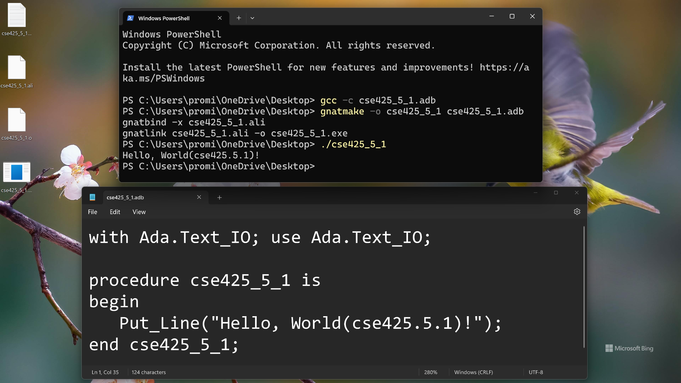

Slide 8
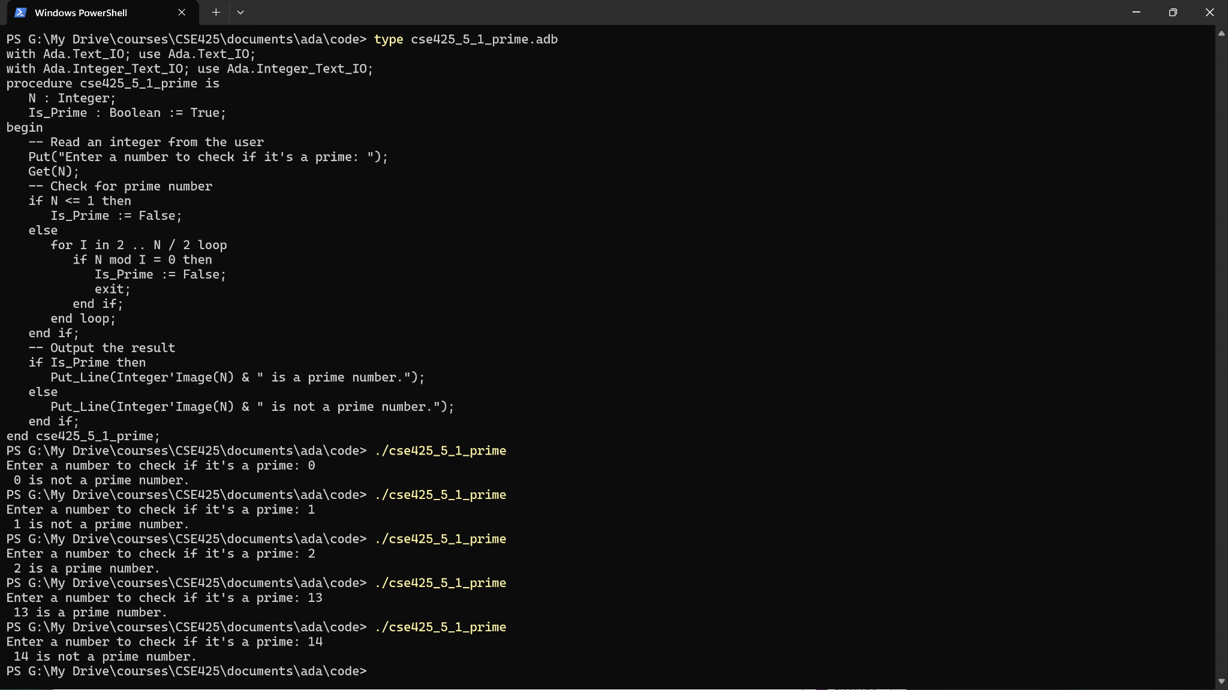

Slide 9
Conclusion
Contribution:
Packages for data abstraction
Elaborate exception handling
Generic program units
Concurrency through the tasking model
Comments:
Very competitive design
Included all that was then known back then
First compilers were very complicated
The first really usable compiler took nearly 5 years to implement
Observations:
Robust and reliable
Safe and secure
Maintain & scaled
Good community & support
Last stable release was in May 2023
Still relevant!

Slide 10
References
https://en.wikipedia.org/wiki/Ada_(programming_language)
https://en.wikipedia.org/wiki/GNAT
https://en.wikipedia.org/wiki/GNU_Compiler_Collection
https://gcc.gnu.org/install/binaries.html
https://www.mingw-w64.org/downloads/
https://www.msys2.org/
https://piembsystech.com/introduction-to-ada-programming-language/

Slide 11
Thank you all! 😊

